Slide 1
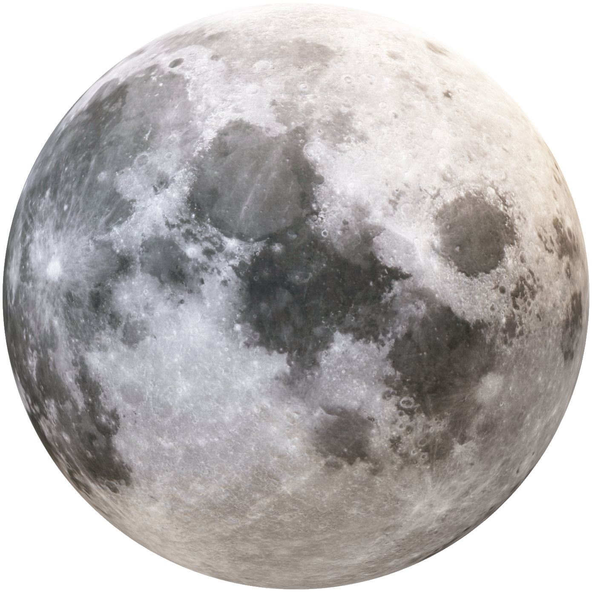
Exploring Computational Geometry in Three.js…..!
SOLAR SYSTEM USING THREE.JS
Guided By:
Smita Kandekar Mam
Mukund Thakre Sir
Presented By:
Abhishek Sahani
Pranit Awale
Rohini More
Deepali Ghumare

Slide 2
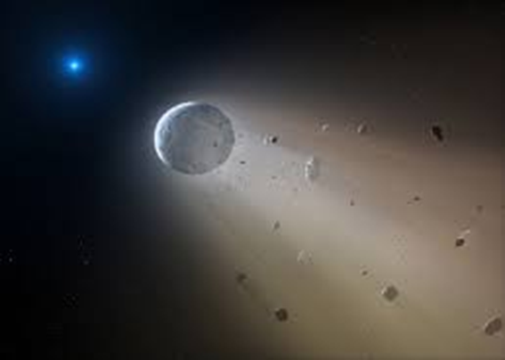
INTRODUCTION
"Our project is like creating a playground in space using the Three.js library. We're building a solar system with the sun, eight planets, moons, and more. They'll all move around and make a cool dance just like in real space.
Discover the magic of computational geometry as we explore how shapes and structures are created and manipulated in our 3D solar system project. Uncover the secrets of algorithms and mathematical principles that make our virtual universe come alive .
Get ready to embark on an immersive journey through the cosmos right from our web browser!

Slide 3
OBJECTECTIVE
Visualize Geometric Objects: Visualize 3D geometric objects accurately.
To study the rotation .
Understand Perspective projection real life application.
Understand orthographic projection .

Slide 4
THREE.JS LIBRARY
Three.js, at it's core, is a library that allows you to add and describe data in 3 dimensions, e.g. as meshes and lights, and then convert that data into a 2d representation onto a HTML canvas.
Before we can do anything with Three.js, we need 3 things,
1.Scene
2.Camera
3.Renderer

Slide 5
Scenes
Scenes allow you to set up what is to be rendered by three.js and where it is in 3D coordinates. We need a scene, The scene is also sometimes referred to as the scene graph. We can have multiple scenes.
When we have a scene, you can then add objects and lighting.

Slide 6
Renderer
The Renderer displays the scene onto a HTML Canvas Element.
The WebGLRenderer is the go-to choice for rendering in Three.js.
It's tasked with translating scene and camera data into visuals displayed on an HTML Canvas Element.

Slide 7
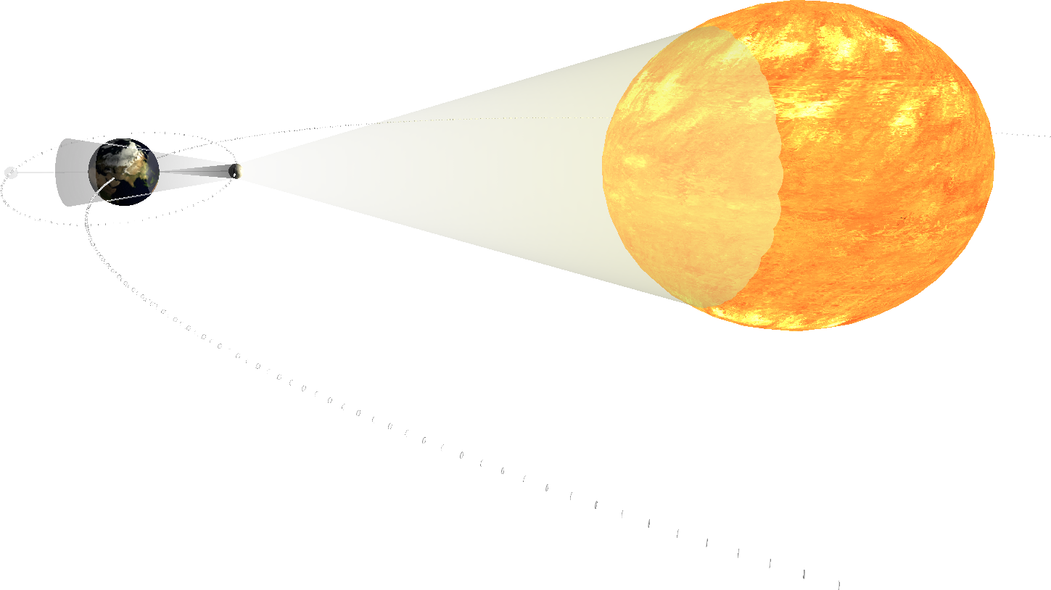
Camera
There are many types of Cameras in Threejs.
The camera properties describe a Frustum which are the dimensions inside the scene that will be rendered

Slide 8
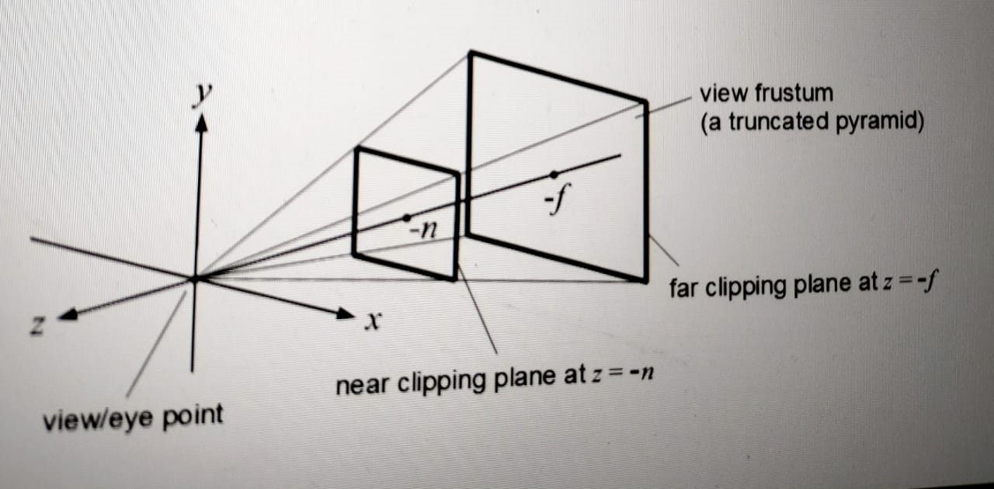
The Perspective projection is designed to mimic the way the human eye sees. It is a very common projection mode used when rendering 3D scenes..

Slide 9
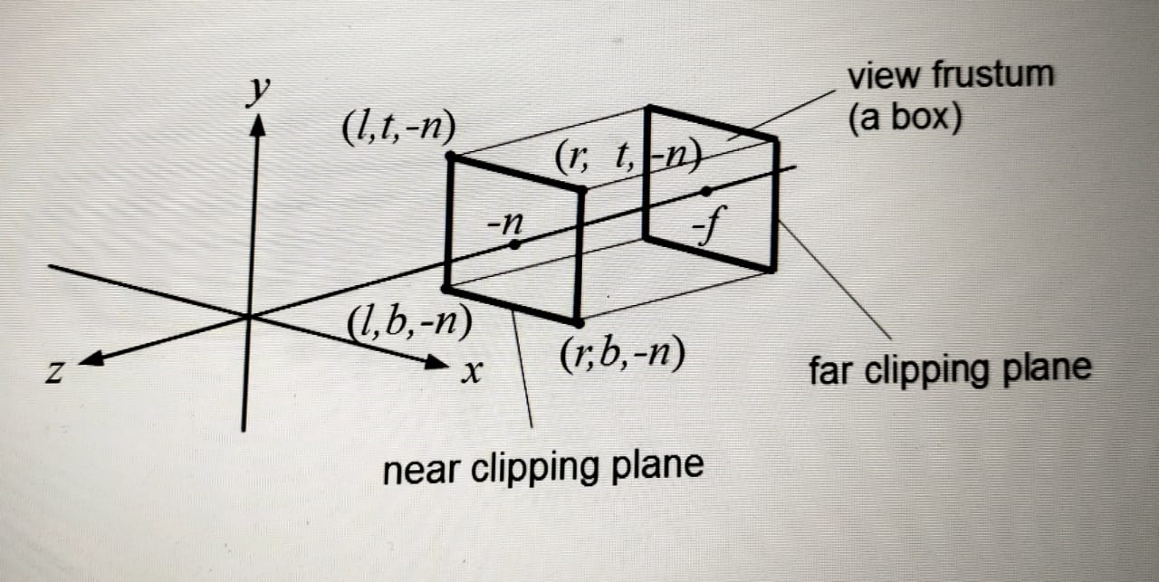
The Orthographic projection is like a cube in itself where the perspective remains constant regardless of it's distance from the camera.

Slide 10
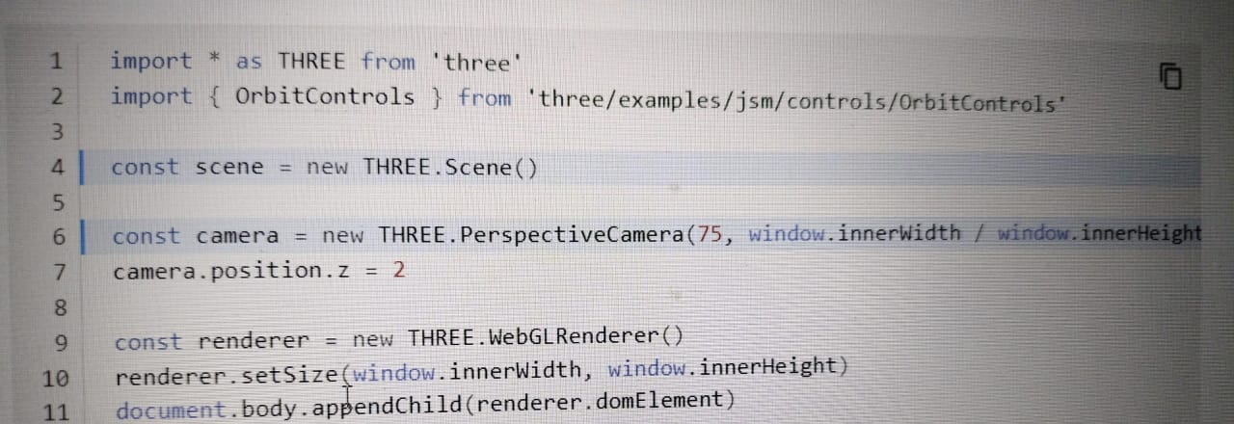
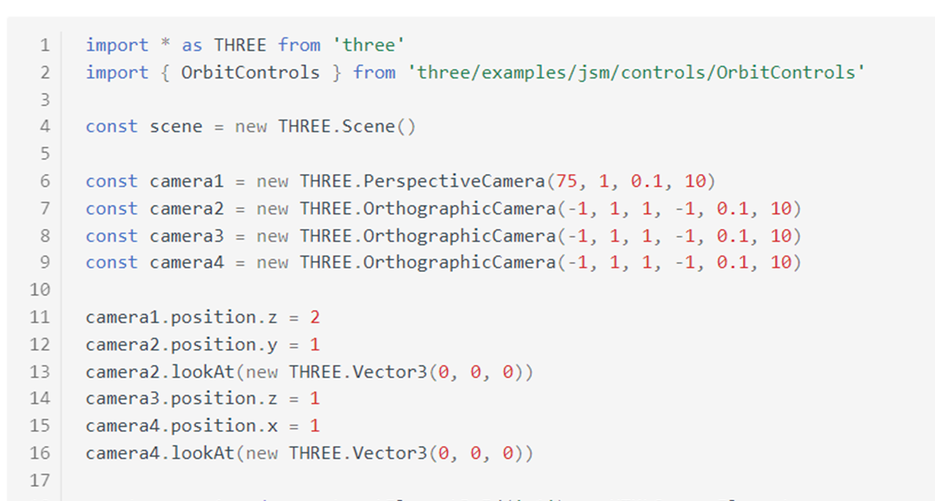

Slide 11
Geometries
In Three.js, "geometry" refers to the representation of 3D objects in a virtual scene.
Geometries define the shape and structure of objects, such as cubes, spheres, planes, or custom models.
They contain information about vertices (points in 3D space), edges (lines connecting vertices), and faces (polygons formed by connecting vertices).
We can have multiple Geometries like BoxGeometry , SpereGeometry , CircleGeometry .

Slide 12
Materials
In Three.js, a "material" is an object used to define the visual appearance of geometries in a 3D scene.
Materials determine how light interacts with the surface of an object and how it is rendered on the screen.
They control properties such as color, shininess, transparency, and how they react to light sources.

Slide 13
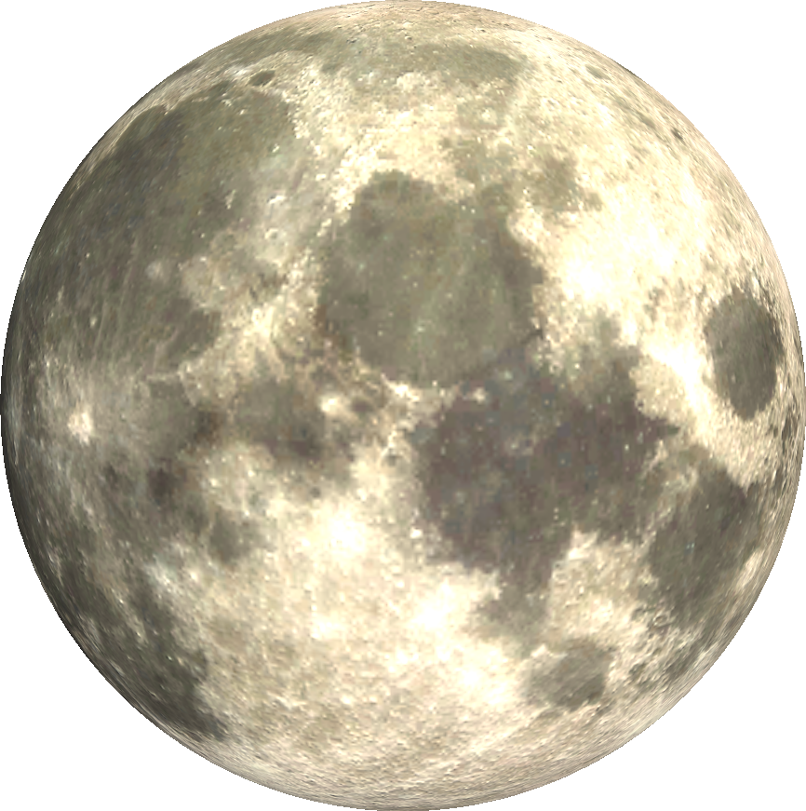
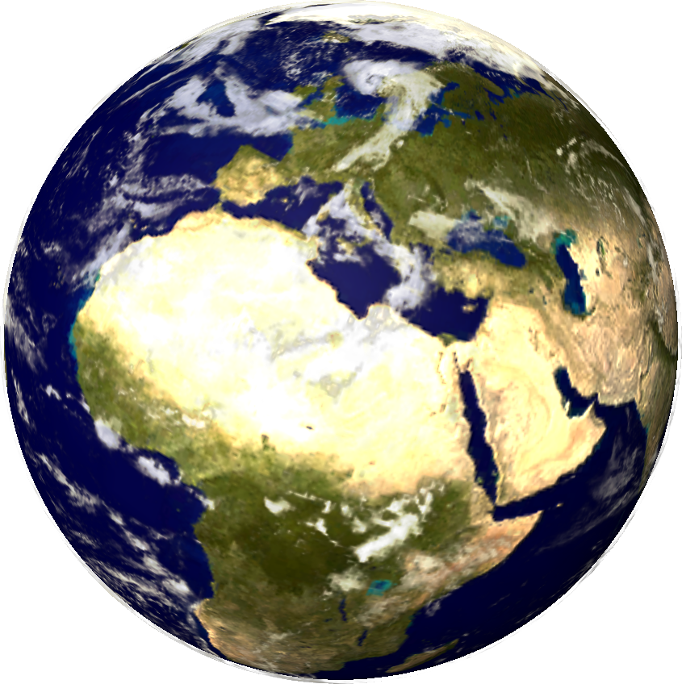
TEXTURE
In Three.js, a "texture" refers to an image applied to the surface of a 3D object, adding detail, color, and visual interest to the object's appearance.

Slide 14
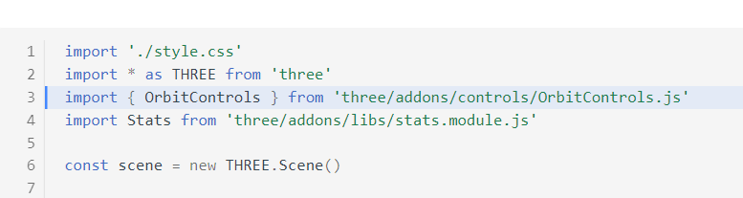
The Orbit Controls allows the camera to orbit around a target.
Orbit Controls

Slide 15
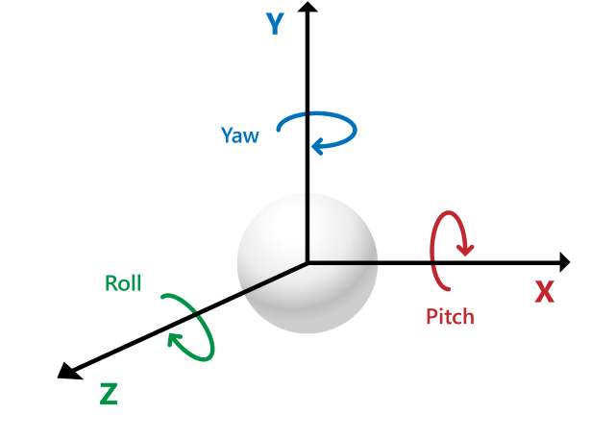
ROTATION
In Three.js, rotation is a fundamental concept used to orient objects in 3D space. Objects such as meshes, cameras, and lights can be rotated around one or more axes to change their orientation relative to the scene.

Slide 16
Lights
In Three.js, "light" refers to a type of object that simulates the behavior of real-world light sources within a 3D scene.
Lights are essential for creating realistic and visually appealing renderings.

Slide 17
Ambient Light
Lights all objects in the scene equally, except for self illuminating objects such as MeshBasicMaterial, MeshNormalMaterial and MeshMatcapMaterial.
Doesn't cast shadows.

Slide 18
PointLight
This light emits light in all directions from a single point in space.
It is often used to simulate light bulbs or other small light sources.

Slide 19
CONCLUSION
Solar system project using Three.js helped us explore how things in space can be shown on a computer.
used concepts like how to place things in space, how to make them move, and how to make them look real.
By doing this project, we learned more about how computers can help us understand space better.
project showed us that understanding how things move and look in space can be important for making cool computer graphics.In the future, we can use these ideas to make even more amazing visualizations in different areas.

Slide 20
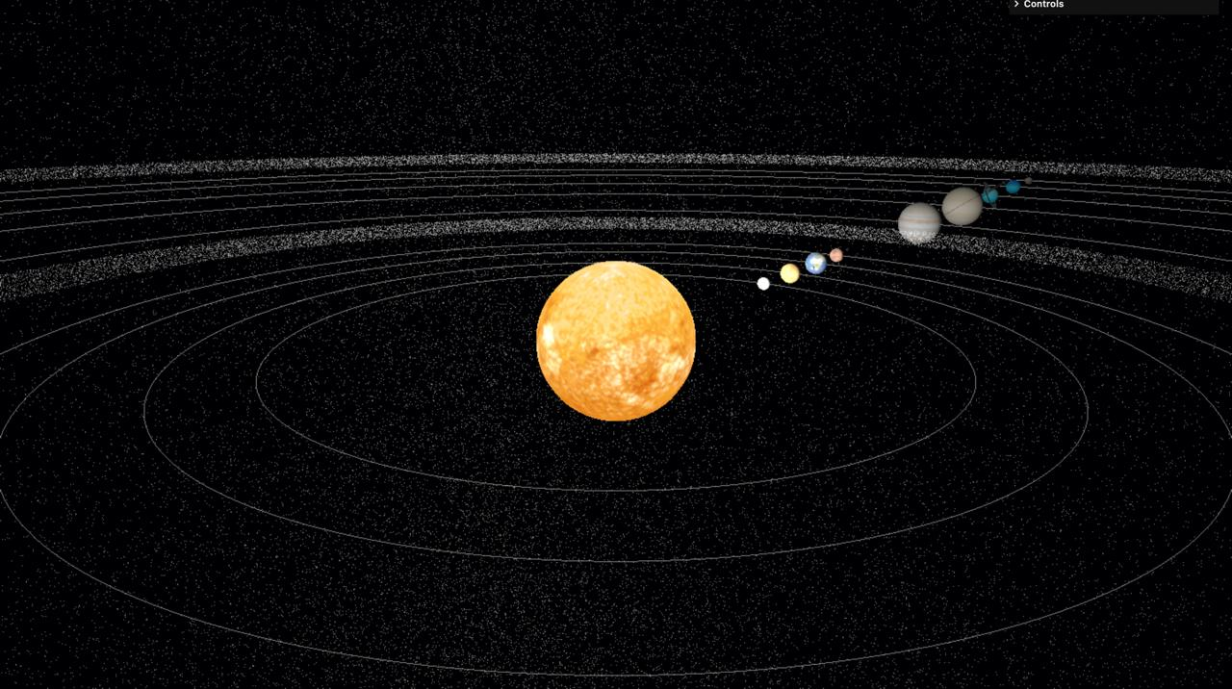
THANK YOU

